Slide 1

Neural Network And Fuzzy Logic
Lung Cancer Prediction using Neural Network Model
Presented By
MD.Mohiuddin Faysal
ID: 1903610201765
Prima Das
ID:1903610201766
Presented To
Faisal Ahmed
Assistant Professor
Department of CSE
Premier University

Slide 2










Outline
Related Work
Methodology
Analysis
Conclusion
Appendices
Introduction
Data collection
Experiment Result
Discussion
Reference

Slide 3



Introduction
Motivation
Early detection through a lung cancer prediction model can significantly improve patient outcomes and save lives
Objective
The objective of a lung cancer prediction model is to identify individuals at higher risk of developing lung cancer and enable early detection for improved outcomes.
Dataset Background
Lung Cancer prediction using neural network

Slide 4
Background
Lung cancer is a major cause of cancer-related deaths worldwide. Early detection is key to improving outcomes, and this model have been developed that use risk factors to identify individuals at higher risk of developing the disease
Machine learning has led to more accurate and precise prediction models.
Artificial neural network, and other computational methods are used to predict Lung Cancer .

Slide 5

Motivation
Early Detection: Early detection of lung cancer is crucial for improving patient outcomes. The use of ANN by point can help in the early detection of lung cancer by predicting the probability of lung cancer based on various input variables such as age, smoking history, family history, and medical history.
Improved Accuracy: ANN can process large amounts of data and identify complex patterns that may not be apparent to humans. By analyzing multiple factors and patterns, ANN can improve the accuracy of lung cancer prediction compared to traditional diagnostic methods.
Cost-effective: ANN by point can be an affordable alternative to expensive diagnostic tests, such as CT scans, that are typically used to diagnose lung cancer. By predicting the probability of lung cancer based on various input variables, ANN can help identify high-risk patients who require further diagnostic tests.

Slide 6
Related Work
In the field of lung cancer research, there has been a significant amount of related work conducted by researchers around the world. We collect several research paper related to Artificial Neural Network about Lung Cancer prediction.
The related work is discussed presents a variety of techniques for the detection and diagnosis of lung cancer. These techniques include artificial neural networks,. Support vector machines and feed-forward backpropagation neural networks have been identified as effective classification tools for the detection of lung cancer.
Kuruvilla et.al presented a Computer Aided Diagnosis classification method in Computed Tomography images for cancer detection based neural network.
Kaur et.al assessed a new feature selection technique using hybrid genetic and particle swarm optimization and classification of lung CT images utilizing MLP-NN is investigated
Krishnaiah et.al gives an outline of the diagnosis on different lung cancer datasets by employing the data mining techniques and optimization techniques for the diagnosis of lung cancer.

Slide 7


Data Collection
Kaggle
Primary Source
Secondary Source
Our Dataset

Slide 8
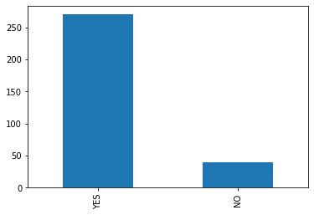
Dataset description
The dataset is about lung cancer. The dataset contains 309 different persons information according to some features. The features are :
Allergy
wheezing
cough
Shortness_of_Breath
Chest_pain
Lung_Cancer
Age
Smoking
Anxity
Peer pressure
Chronic
Disease
Fatigui
Fig: Glimpse of dataset

Slide 9
Dataset of the Project
Gender | Age | Smoking | Anexity | Peer pressure | Chronic Disease | Fatigui | Allergy | wheezing | cough | Short ness_ of Breath | Chest pain | Lung Cancer
M | 69 | 1 | 2 | 1 | 1 | 2 | 1 | 2 | 2 | 2 | 2 | Yes
M | 74 | 2 | 1 | 1 | 2 | 2 | 2 | 1 | 1 | 2 | 2 | Yes
F | 59 | 1 | 1 | 2 | 1 | 2 | 1 | 2 | 2 | 2 | 2 | No
M | 63 | 2 | 2 | 1 | 1 | 1 | 1 | 1 | 1 | 1 | 2 | No
Table 01: Table of the Dataset

Slide 10

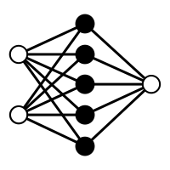


Methodology
Applying Classification Algorithm
Data Preprocessing
Data train & test
ANN Model Design

Slide 11
Data Preprocessing
Level Encoding: Label Encoding refers to converting the labels into a numeric form so as to convert them into the machine-readable form. In our dataset ‘Gender, and ‘Lung_cancer’ columns are text type data. We need to encode them.
No | Gender | Lung_Cancer
01 | Male | Yes
02 | Male | Yes
03 | Female | No
04 | Male | No
No | Gender | Lung_Cancer
01 | 1 | 1
02 | 1 | 1
03 | 0 | 0
04 | 1 | 0
Before Encoding
After Encoding

Slide 12
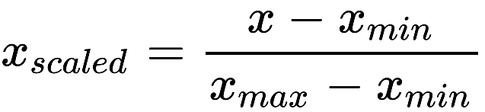
Data Preprocessing
Min-Max Scaling : Min-max normalization performs a linear transformation on the original data. This technique gets all the scaled data in the range (0, 1).The formula to achieve this is the following:
Here we show ‘Age ‘ column scaled
No | Age
01 | 69
02 | 74
03 | 59
04 | 63
No | Age
01 | 0.72727
02 | 0.80303
03 | 0.57575
04 | 0.63636
Before scaling
After Scaling

Slide 13
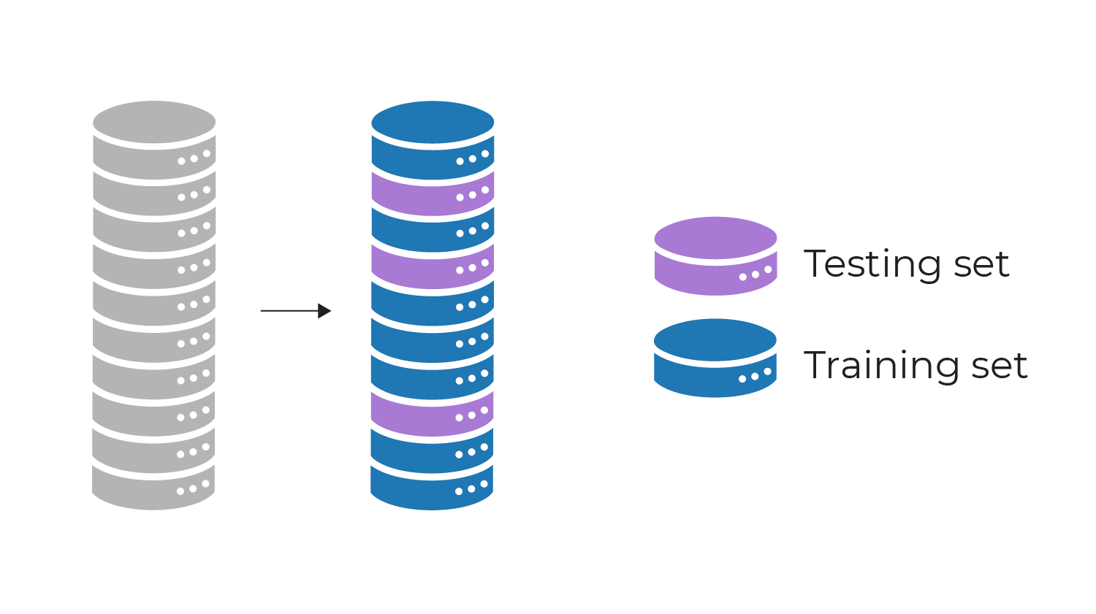
Data train & test
The input data samples are trained and tested by using neural network. Initially the weights of neural network of the input data are chosen randomly. The neural networks are trained with a sample data for learning and to perform classification process then with testing dataset.
The classification result of the tested data is weighed to check the frequency error or the error rate which occur during classification process and the error are resolved by changing the weights in the dataset .
In our experiment 70% data is taken for training and 30% for testing.
30%
70%
Data sample
Train & test data

Slide 14
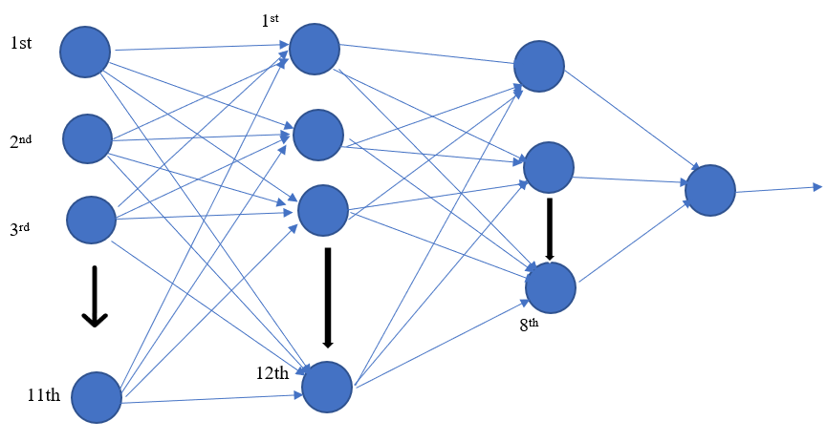
ANN Model Design
Our project Lung cancer prediction is a binary classification model. We show our project both single class and multiclass.
For Single class
1st
Sigmoid function is used as activation function.
Binary cross entropy is used as loss function.
Input layer
1st hidden layer
2nd hidden layer
Output layer

Slide 15
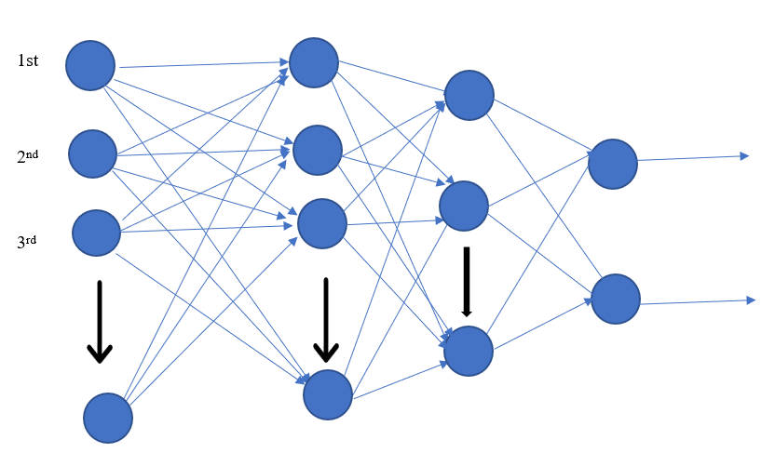
ANN Model Design
For multiclass
1st
1st
Softmax function is used as activation function.
Categorical cross entropy is used as loss function.
1st
2nd
8th
11th
12th
Input layer
1st hidden layer
2nd hidden layer
Output layer

Slide 16
Classification
K-Nearest Neighbor Classifier
Logistic Regression Classifier
Naive Bayes Classifier

Slide 17
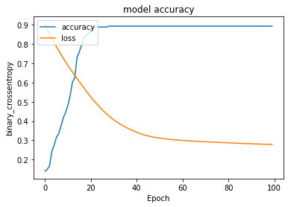
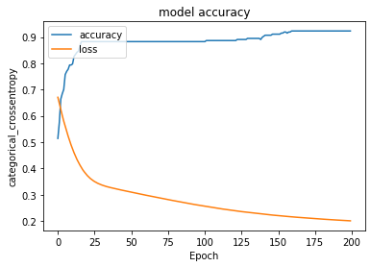
Experiment and Results
A binary classification ANN lung cancer prediction model is designed to predict whether a patient is likely to have lung cancer or not. The model has achieved an accuracy of 82% for a single class and 85% for multiclass classification, which is a reasonably good performance
We have 359 data . From this data we take batch size 200 with 100 epochs. And we got loss: 0.3911 - accuracy: 0.8280
In the multiclass problem we take 128 batch size with 200 epochs. And we got loss: 0.3436 - accuracy: 0.8548

Slide 18
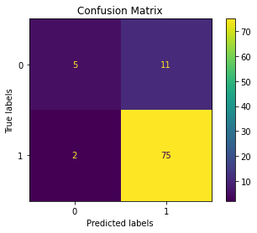
Experiment and Results
We test our model on some classifiers to find best accuracy. And we got different accuracy from different classifiers.
Result for single neuron in output
1. KNN Classifier
Lung_cancer | Precision | Recall | F1-Score | Accuracy
Yes | 0.87 | 0.97 | 0.92 | 0.86
No | 0.71 | 0.31 | 0.43
The classifier gives us 86% accuracy

Slide 19
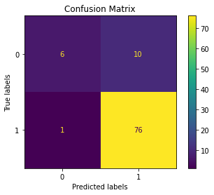
Experiment and Results
2. Naïve bayes classifier
Lung_cancer | Precision | Recall | F1-Score | Accuracy
Yes | 0.88 | 0.99 | 0.93 | 0.88
No | 0.86 | 0.38 | 0.52
The classifier gives us 88% accuracy

Slide 20
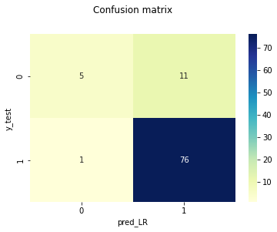
Experiment and Results
3. Logistic regression
Lung_cancer | Precision | Recall | F1-Score | Accuracy
Yes | 0.87 | 0.99 | 0.93 | 0.87
No | 0.83 | 0.31 | 0.45
The classifier gives us 87% accuracy

Slide 21
Experiment and Results
Result for two neuron in output
1.KNN classifier
Lung_cancer | Precision | Recall | F1-Score | Accuracy
Yes | 0.87 | 1.00 | 0.93 | 0.87
No | 1.00 | 0.20 | 0.33
The classifier gives us 87% accuracy of the model

Slide 22
Experiment and Result
2.Naïve bayes classifier
Precision
Recall
F1-Score
Lung_cancer | Precision | Recall | F1-Score | Accuracy
Yes | 0.89 | 0.98 | 0.94 | 89%
No | 0.80 | 0.40 | 0.53
The classifiers gives us 89% accuracy

Slide 23
Analysis
Accuracy for single neuron in output
Accuracy for two neuron in output
Classifiers | Accuracy
KNN | 0.86
Naïve bayes | 0.88
Logistic regression | 0.87
Classifiers | Accuracy
KNN | 0.87
Naïve bayes | 0.88
We see Naïve bayes classifiers gives us 88 % best model accuracy for both single class and multiclass in output layer.

Slide 24
Discussion
Artificial Neural Networks (ANN) are widely used in the field of medical diagnosis and prediction, including the prediction of lung cancer using binary classification.
Binary classification in this context refers to the classification of lung cancer as either present or absent based on a set of input features.
An ANN for lung cancer prediction using binary classification typically involves training a model on a dataset of known cases of lung cancer and non-cancerous lung conditions. The model is trained to recognize patterns in the input features that are associated with lung cancer and use those patterns to make predictions about new cases.

Slide 25
Conclusion
Based on the given information, an ANN model for lung cancer prediction using binary classification has been developed with an accuracy of 88%. This means that the model correctly identified the presence or absence of lung cancer in 88% of the cases it was tested on.
This level of accuracy is promising, but further validation and evaluation of the model's performance would be necessary to determine its suitability for use in clinical practice. It would also be important to ensure that the model is robust and can handle variations in input data, as well as to address any potential biases or limitations in the dataset used to train the model.
Overall, this project demonstrates the potential for ANN models to assist in medical diagnosis and prediction, but highlights the importance of careful development, validation, and evaluation to ensure their effectiveness and reliability in real-world settings.

Slide 26

Reference
When writing about an ANN lung cancer prediction model, it is important to include references to the relevant literature and studies that informed the development and evaluation of the model. We take some research paper information about ANN lung cancer prediction. Those are our reference .

Slide 27
Appendices
An appendix for a lung cancer prediction model report might include additional details about the model, data used for training and evaluation, and technical specifications.
Description of input features: we used 11 input features in our model where ‘Gender’ is categorical and rest of the inputs are numerical .
Model architecture and specifications: our model binary classification lung cancer prediction is used with two ways. Where one neuron is used in output layer and another is two neuron in output layer. Besides we used two hidden layer where 12 neuron in 1st hidden layer and 8 neuron in 2nd hidden layer.
Performance metrics: we used KNN, Naïve bayes , Logistic regression classifiers to find our model accuracy . Where Naïve bayes gives us best accuracy for this model.
Code and software: we used google colab for creating the model with python language.

Slide 28
Thank You

